Slide 1
Workplace Module Project
Khuthadzo Tshikovhele
Title: Indian Agriculture Dataset: Crop Production Forecasting

Slide 2
Understanding Indian agriculture
This presentation outlines the development of a hybrid recommender system for anime titles. It combines collaborative filtering and content-based filtering to predict user preferences.
Table of Content
Introduction
Package Installation
Data Cleanup
Model Evaluation
Final Model Summary
Key Insights and Conclusion

Slide 3

Introduction
Problem Statemen:
India’s agricultural sector is vital to the economy but faces data management challenges.
Agricultural data is complex, fragmented across regions, and not easily accessible.
Lack of consolidated data makes it hard for farmers, policymakers, and researchers to make informed decisions.
Project Goal
Develop a data visualization platform that integrates agricultural data from states and districts.
Provide insights into crop production, yield statistics, and cultivated areas.
Enable users to identify patterns, gaps, and regional disparities.
Impact
Empower farmers to make better crop choices.
Support policymakers in targeting interventions effectively.
Assist researchers in analysing agricultural trends.

Slide 4
Powerful Toolkit of Packages that we used:
Scikit-surprise: Essential for machine learning tasks, including preprocessing, modeling, and evaluation.
SciPy: is a Python library specifically designed for building and evaluating recommender systems using explicit rating data
Matplotlib/Seaborn: Crucial for creating various types of visualizations.
NumPy: Fundamental for numerical operations, supporting arrays and matrices.
Pandas: Essential for data manipulation, including reading, cleaning, and analysing data
Jupyter Notebook: Facilitates an interactive environment for coding and data exploration.
These libraries support data processing, visualization, and model building.

Slide 5
Data Clean-up
I conducted several data preprocessing tasks to ensure our dataset was well-prepared for analysis and visualization:
Handled missing values
Filtering Data: Selected specific data based on conditions..
Column Names: Checked and displayed column names.
Initial Data Display: Showed the first few rows for a quick overview.
Loading the Dataset: Imported the data into a dataframe
Removed duplicate entries
Filling Missing Values: Replaced NaNs with column means.
Ensured consistent data types
This comprehensive approach resulted in cleaned and reliable dataset ready for analysis.

Slide 6
Model Evaluation
Purpose: Assess effectiveness and accuracy of predictive models for crop production forecasting.
Evaluation Metrics:
R² Score: Explains variance in target.
RMSE: Measures prediction error magnitude.
(For classification: Accuracy, Precision, Recall, F1-score.)
Model Performance:
Linear Regression: R² ≈ 0.65, higher error.
Random Forest: R² ≈ 0.85, lower error.
Interpretation: Random Forest is more accurate and preferred.
Summary:
Random Forest shows superior performance and robustness.
Models generalize well to unseen data.
Future Improvements:
Add features (rainfall, soil type).Apply cross-validation for reliability

Slide 7
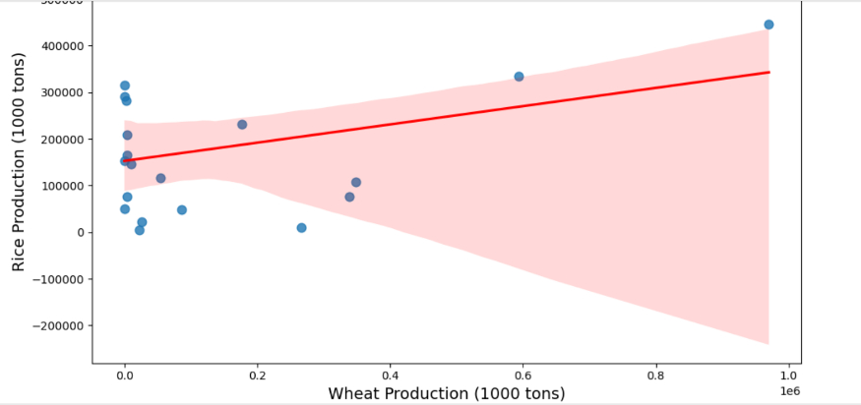
Model Evaluation
Feature Importance (Random Forest)
Interpretation:
Random Forest captures non-linear relationships and interactions.
• Rice Area is the most influential predictor.
• Residuals from Random Forest are more evenly distributed, indicating better fit.

Slide 8
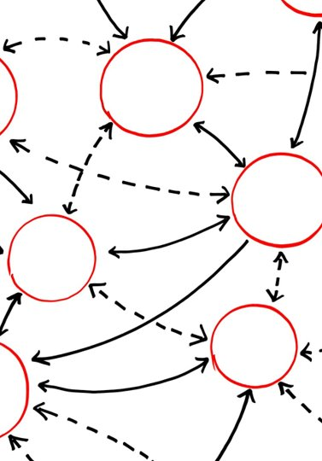
Final Model Summary
Final Model Code Snippet
Random Forest Overview
Random Forest combines multiple decision trees to enhance accuracy and reduce overfitting in regression tasks.
Model Implementation Steps
The model is imported, instantiated, trained on training data, and used to predict outcomes on test data.
Application in Agriculture
The model predicts agricultural yield by capturing complex relationships in input data effectively.
Future Enhancements
Enhancements include hyperparameter tuning, cross-validation, and feature engineering for improved results.

Slide 9
Final Model Summary
Feature Importance (Random Forest)
Feature​ | Importance​
Rice Area​ | 0.45​
Wheat Area​ | 0.35​
Maize Area​ | 0.20​

Slide 10
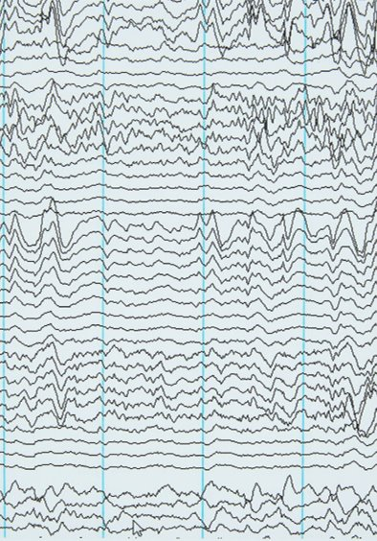
Final Model Summary
Residual Plot (Random Forest)
Purpose of Residual Plot
Residual plots visualize differences between actual and predicted values to evaluate regression model performance.
Indication of Model Fit
Evenly distributed residuals around zero indicate no bias and good fit for the Random Forest model.
Detecting Outliers and Issues
Residual plots help identify outliers and problem areas, guiding model refinement and improvement.
Model Monitoring Importance
Regular residual monitoring ensures sustained model accuracy in changing environments and new data.

Slide 11

Recommendations
Focus on Rice Cultivation
Prioritize increasing rice cultivation area to improve predictive accuracy as it is the most influential factor.
Monitor Wheat and Maize
Closely monitor wheat and maize areas since they significantly contribute to yield predictions.
Utilize Random Forest Model
Continue using Random Forest model for its robustness and reliable residual distribution.
Feature Engineering Exploration
Explore feature engineering to discover new predictors or transform existing features for better generalization.

Slide 12
Key Insights and Conclusion
Summary of Findings:
The Random Forest model demonstrated strong predictive performance, with residuals evenly distributed around zero, indicating minimal bias and good generalization. Feature importance analysis revealed that Rice Area is the most influential predictor, followed by Wheat Area and Maize Area, highlighting the critical role of crop-specific data in yield forecasting.
Insights Gained:
Accurate measurement of Rice cultivation areas significantly impacts prediction accuracy.
Wheat and Maize areas provide secondary but meaningful contributions.
Random Forest’s robustness makes it suitable for agricultural yield prediction tasks.
Limitations:
The dataset may lack granularity in environmental factors (e.g., soil quality, rainfall).
Limited temporal data restricts the ability to capture seasonal variations.
Model interpretability remains a challenge compared to simpler algorithms.
Future Directions:
Data Enrichment: Incorporate weather, soil, and irrigation data for improved accuracy.
Model Optimization: Explore hyperparameter tuning and ensemble approaches.
Feature Engineering: Develop derived features (e.g., crop rotation patterns).
Monitoring & Maintenance: Implement model drift detection and periodic retraining.
Scalability: Extend the methodology to other crops and regions for broader applicability.

